Slide 1

Cyberbullying Detection on Social
Networks using Machine Learning
PRESENTER
Prithvi Bidkar (B-35)
PROJECT GUIDE
GHRCE

Slide 2

Introduction
Cyberbullying has become a serious concern in today's digital age, particularly on social media platforms. These platforms, while offering incredible opportunities for connection and communication, can also be breeding grounds for harmful behavior.
Early studies focused on simple methods like analyzing the frequency of certain keywords or using rule-based systems to identify potentially offensive language.
By analyzing the language used in social media posts, machine learning models can be trained to identify patterns and characteristics that are indicative of cyberbullying behavior. This technology has the potential to significantly improve our ability to identify and prevent cyberbullying, creating a safer and more positive online environment for everyone.

Slide 3
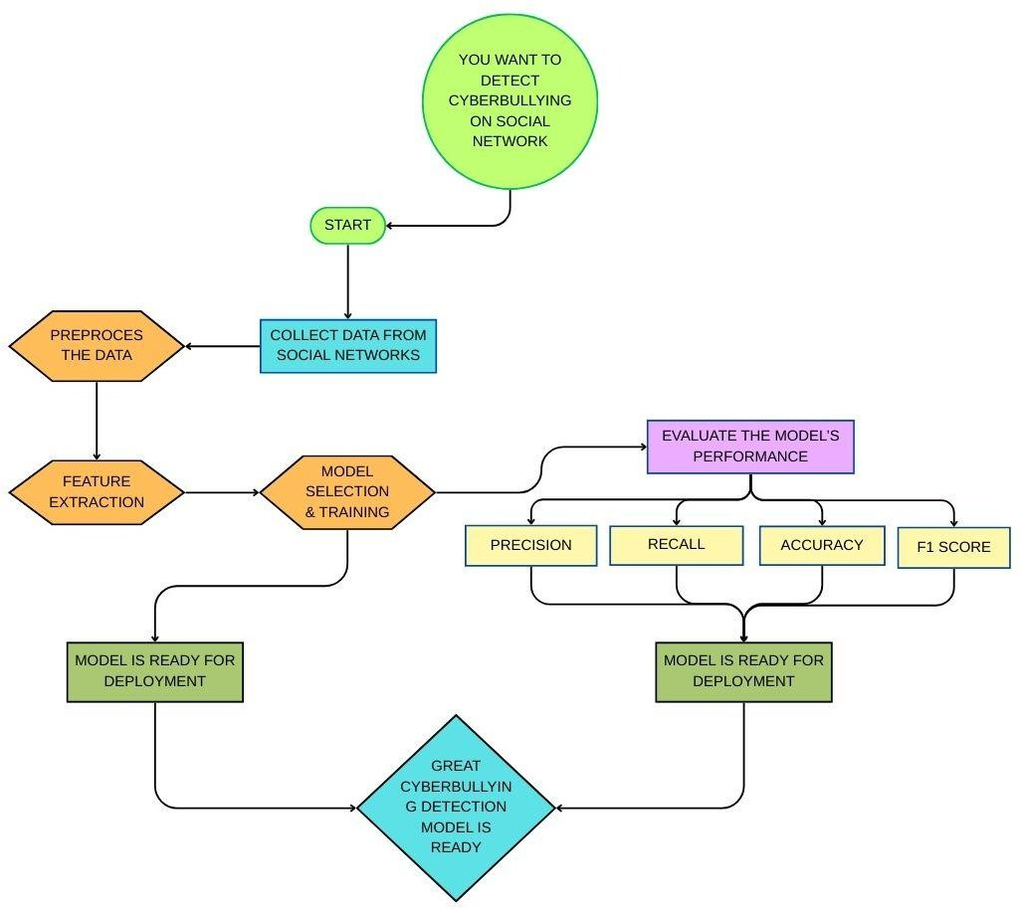
Workflow Diagram

Slide 4
Overview of Workflow
The project aims to identify and prevent cyberbullying, creating a safer and more positive online environment for everyone.
Phases:
This workflow consists of two main phases:
Data Collection and Preprocessing : We will gathered social media text data, which includes both cyberbullying instances and normal conversations. And collected text was cleaned by removing irrelevant characters and transformed into a numerical format suitable for machine learning.
Model Selection and Evaluation: We will explored several machine learning models after comparing performance metrics across algorithms to ensure optimal cyberbullying detection.
Results demonstrate the model's effectiveness in distinguishing between cyberbullying and non-cyberbullying content with a high degree of accuracy.

Slide 5
Data Collection and Preprocessing
Data Collection: We'll gather a dataset of social media text messages, including examples of both cyberbullying and non-cyberbullying content.
Data Preprocessing: This crucial step involves cleaning and preparing the raw text data. We'll remove irrelevant characters like URLs and emojis, handle missing values, and convert text to lowercase. Techniques like stemming will be applied to reduce words to their root forms, simplifying the analysis and improving model performance.
Feature Extraction: To make the text data understandable for machine learning models, we'll use techniques like the Bag-of-Words approach. This method represents text as a collection of words, where each word is provided a weight based on its frequency within the document. This numerical representation allows the machine learning algorithms to effectively analyze and learn from the text data.

Slide 6
Model Selection and Evaluation
Model Selection and Training: We'll experiment with different machine learning algorithms, including Naive Bayes, Support Vector Machines (SVM), and Random Forest. These algorithms will be trained on the preprocessed and transformed data. During training, the models will learn to identify patterns and relationships within the data that distinguish cyberbullying from non-cyberbullying messages.
Model Evaluation: We will rigorously evaluate the performance of our trained models using metrics such as accuracy, precision, recall, and F1-score. These metrics will help us determine how effectively the models can identify cyberbullying while minimizing false positives and negatives.

Slide 7
THANK YOU

